Slide 1
RUN LLM AI’s Locally
FT – Ollama, Open-Web-UI Manoj Kumar CHOLLANGI
github.com/chollangimanojkumar

Slide 2
Contents
Introduction
Architecture
Requirements
Installation
Tuning
Conclusion

Slide 3
The Power of
ANY Large Language AI Models in your system locally

Slide 4
Running AI Models locally
We can build our own AI language models for general purpose locally
Once it completes the installation, Doesn’t need Internet to work/Think
Keep your data local
Tune and make specialized AI experts based on your requirements and pre-shared resources
Ability to share images to AI models and analyze the contents

Slide 5

Setup
Architecture

Slide 6
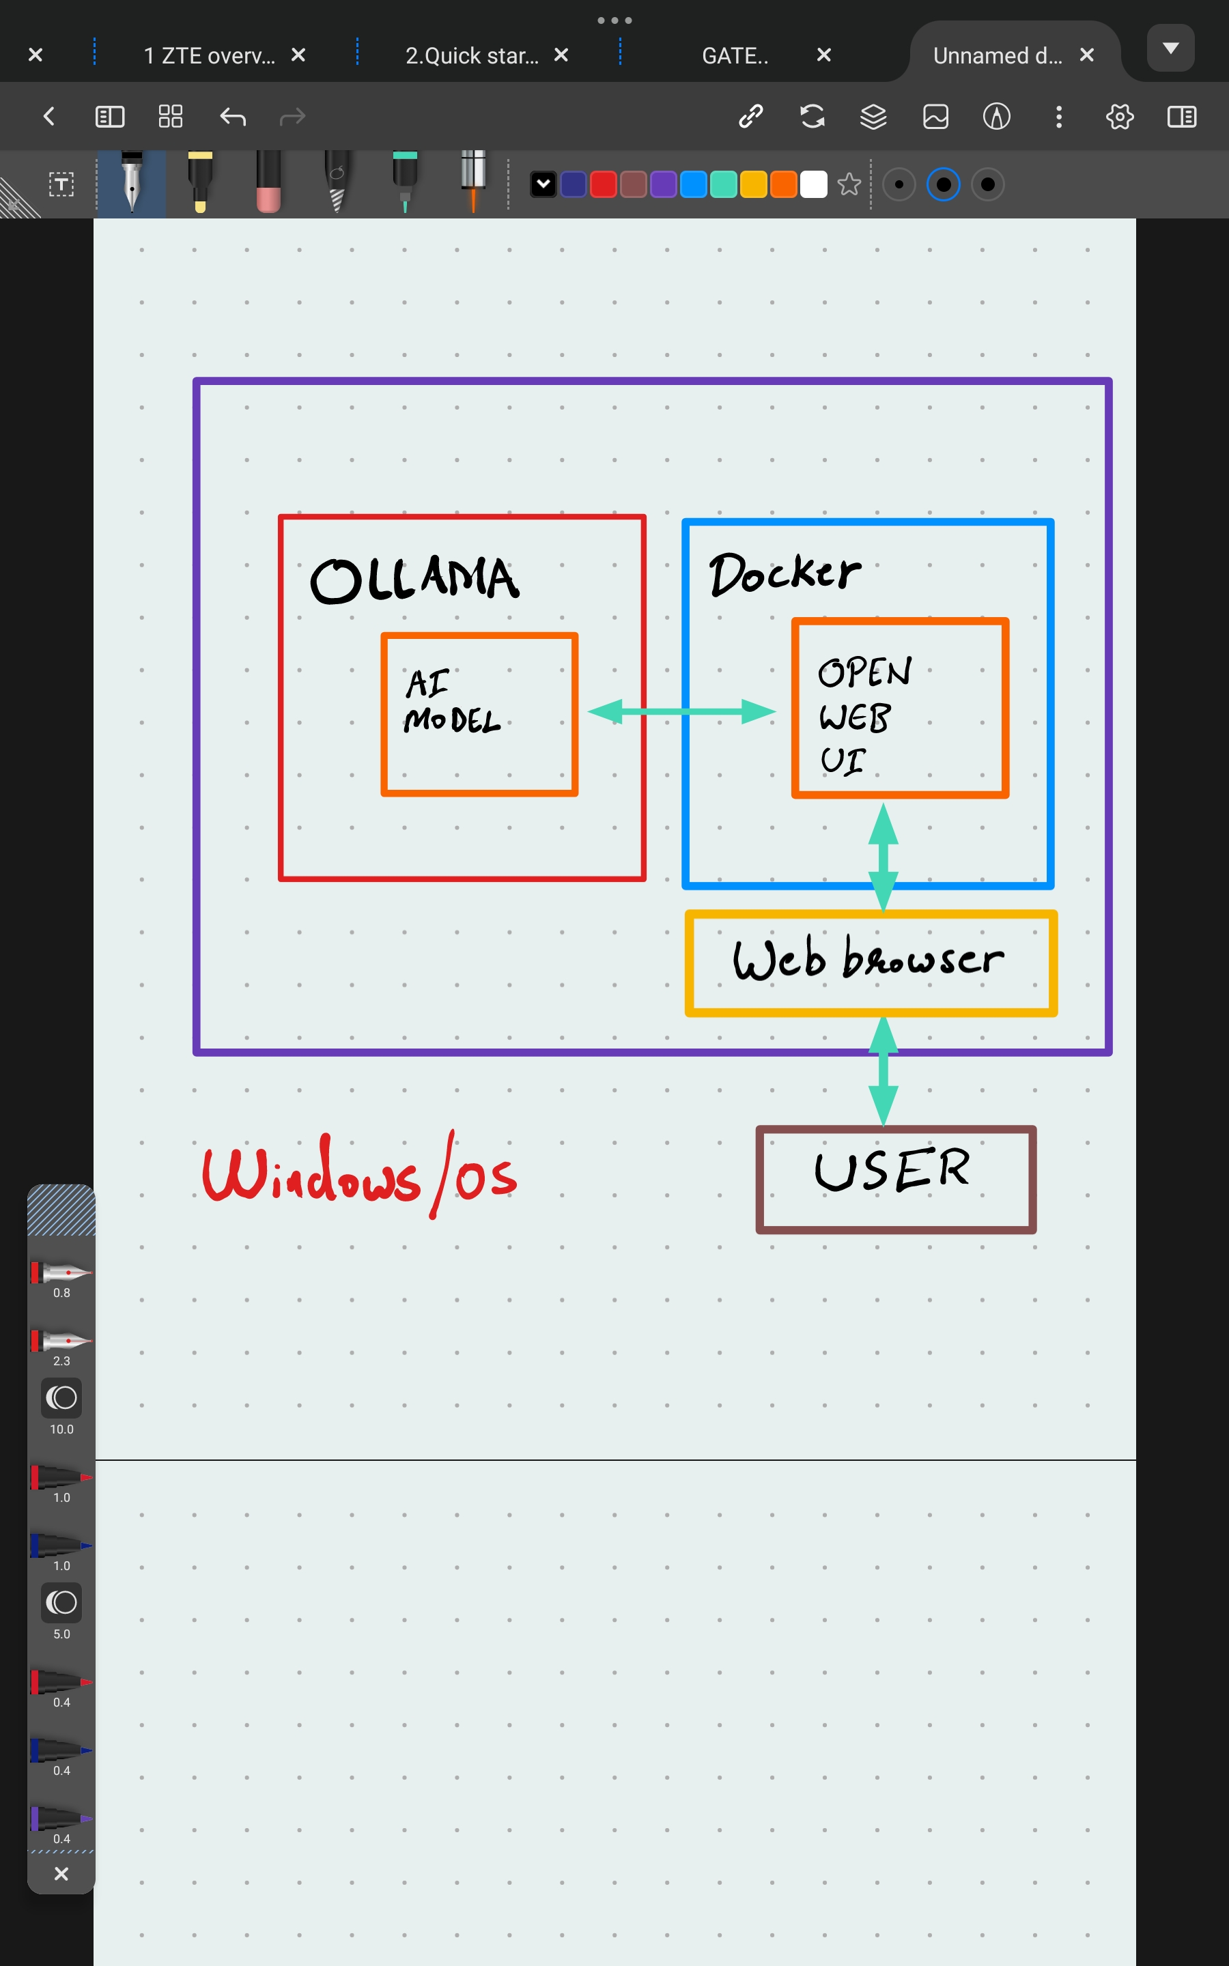
Architecture

Slide 7
Requirements

Slide 8
Requirements
Need a system with atleast 8GB RAM
The higher the available memory the higher the responsiveness
Need a good GPU(graphics card)
The Higher the GPU Memory the faster response from model
Atleast 15 GB free space to install the software and AI models
A good multiprocessor CPU with 4 cores or higher
Need to enable virtualization for docker

Slide 9
Installation
Start building your setup

Slide 10
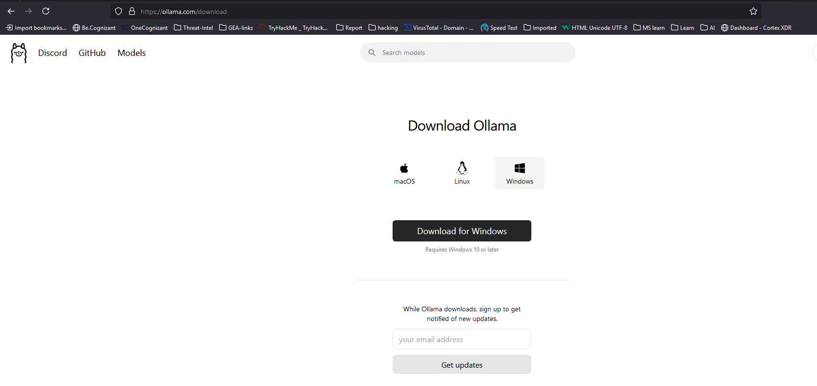
Installation
Step 1:
Download and install Ollama
Ref: https://ollama.com/

Slide 11
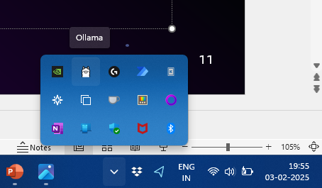
Installation
Once the installation is complete you could see the Ollama app in your installed applications list but you don’t see any GUI(graphical user interface)
You can verify if its running by looking at the action center
Ollama can only be used via CLI (Command Line Interface)
Open Ollama app
Open CMD – command prompt / terminal
Type in Ollama -h

Slide 12
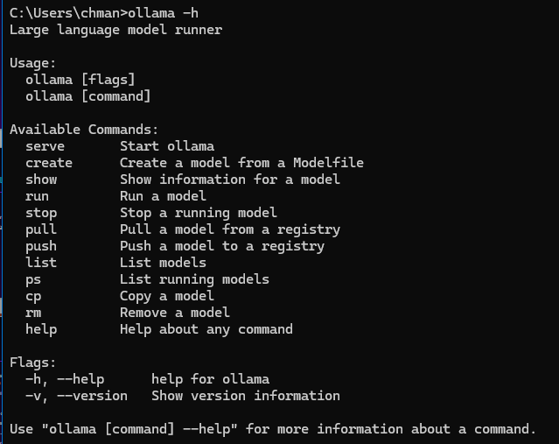
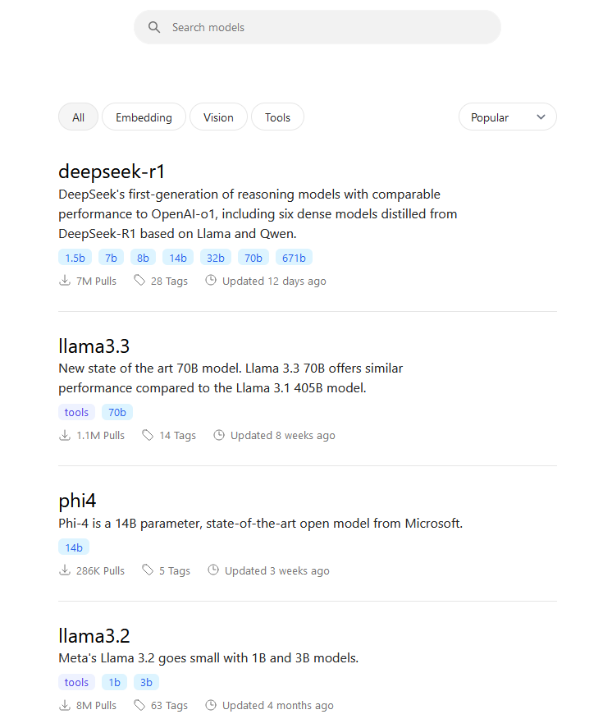

Installation
Now we could see the Ollama up and ruining
Select a good model you want to run in your system
Ref: https://ollama.com/search
Select the Parameter for model (b - billion parameters)
The higher Parameter models needs more resources

Slide 13
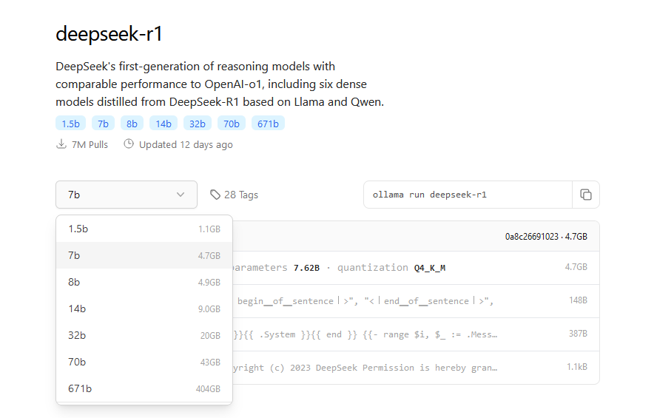
Installation
Select the model with right parameter based on your system specifications
Larger models have higher accuracy but need more resources
Lighter Models use less resources and offer less accuracy

Slide 14
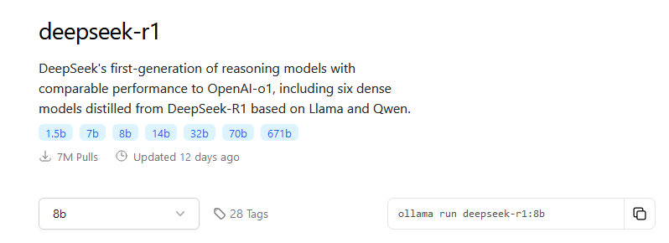
Installation
The command to install the model is shown
Ollama run deepseek-r1:8b
Use this command in Cmd or terminal to install and run the LLM model in CLI

Slide 15
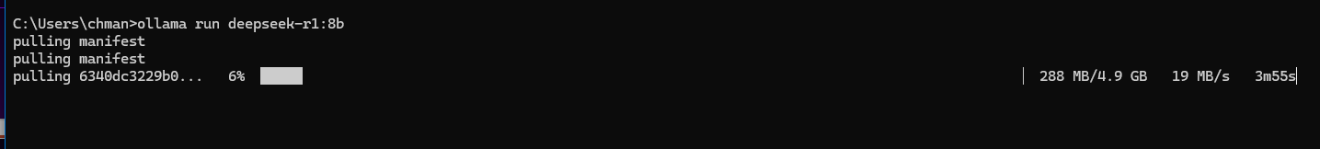
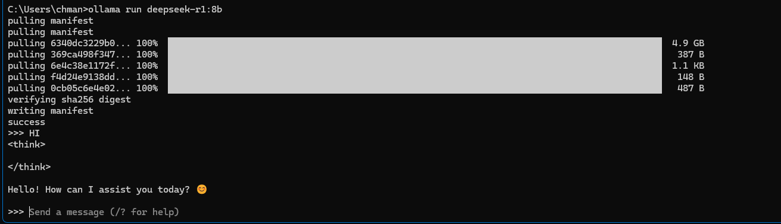
Installation
Installation is in progress
Installation completed with CLI

Slide 16
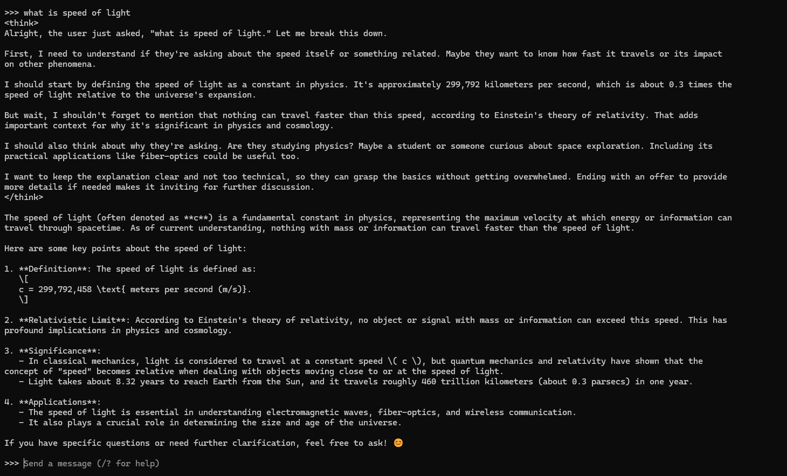
Using/TESTING the OLLAMA CLI
Using the CLI:
You can use the Local AI directly from CLI
Type your query and let the AI model think or answer your question

Slide 17
Using/TESTING the OLLAMA CLI
We can run the CLI
Its slight inconvenient for normal users to access the LLm model via commandline
Hence we install a opensource tool called OPEN-WEB-UI to get a Web interface
As per our architecture and simple management we can run this in Docker to simply start or stop the service when needed
Use /bye to stop and exit the model cli
Use Ollama serve to serve the Ollama service to Web UI
Now let’s proceed with the OPEN WEB-UI installation for GUI(Graphical User Interface)

Slide 18
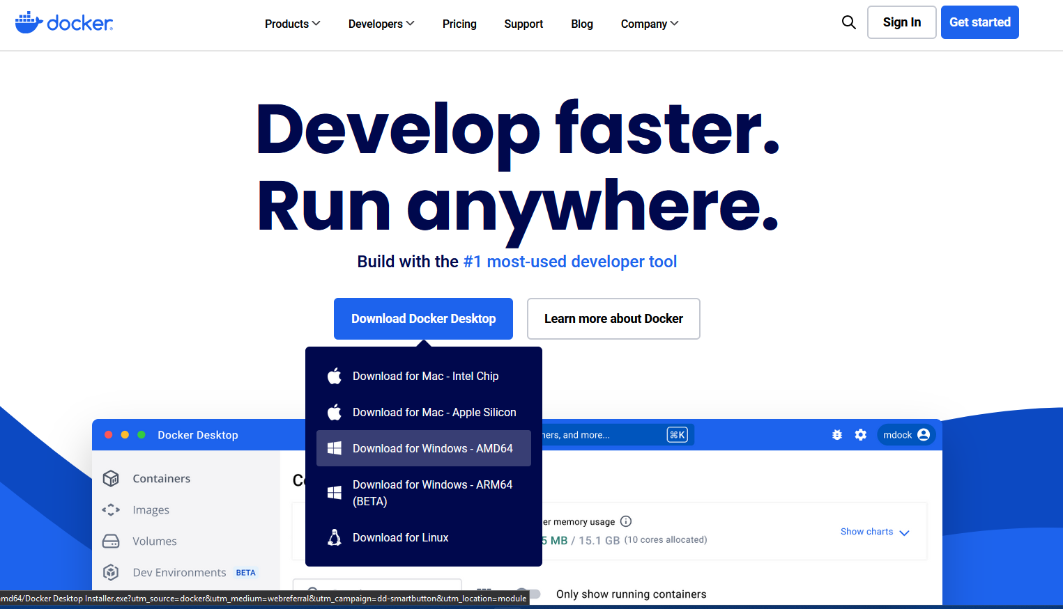
Installation of OPEN-WEB-UI
You could use any containerization software such as Docker or Podman (Opensource)
For this demonstration we are using Docker
Download and install Docker
Ref: https://www.docker.com/
Install Docker, create a Docker account and login (required only once)
*Docker needs WSL(Windows Subsystem for Linux)
REF: https://learn.microsoft.com/en-us/windows/wsl/install

Slide 19
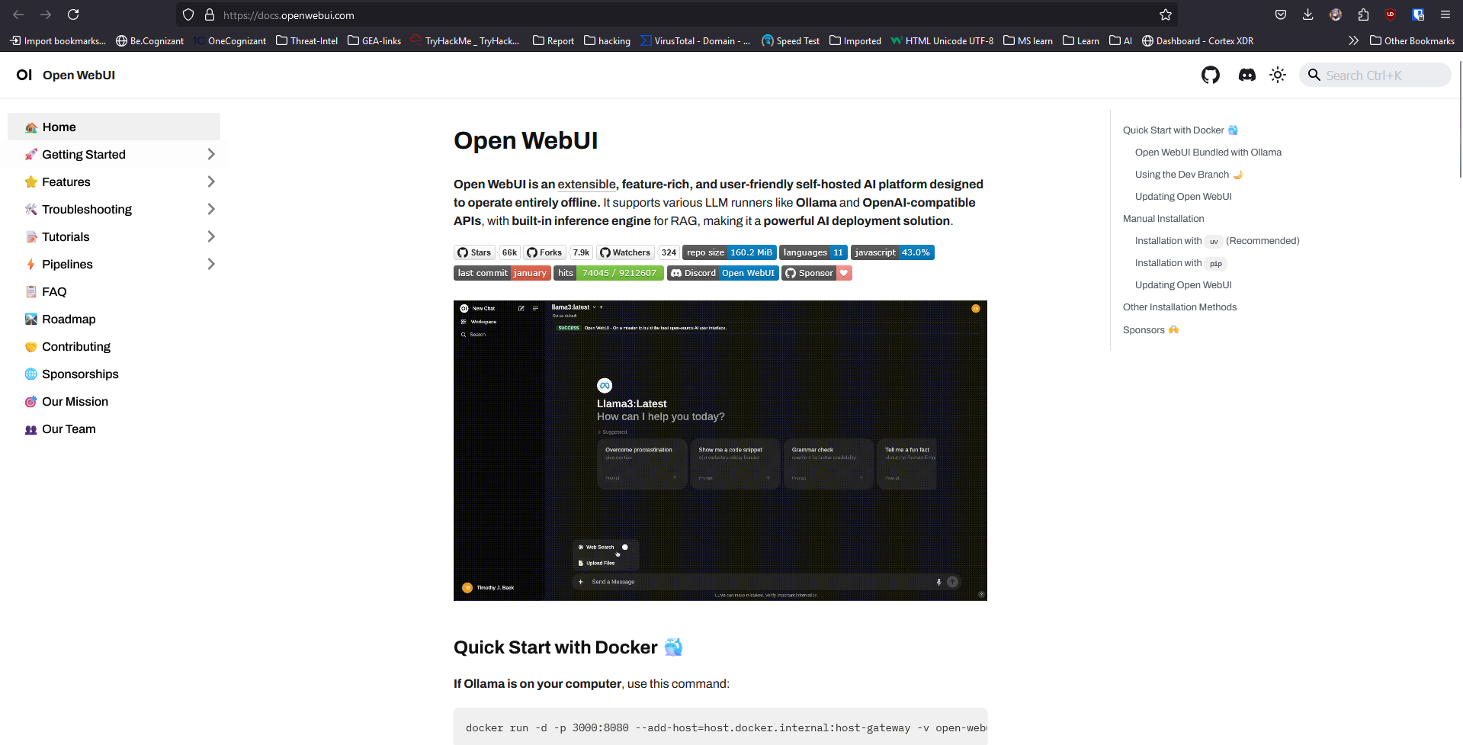
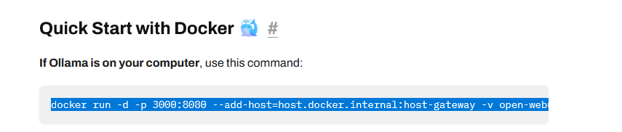
Installation of OPEN-WEB-UI
Go to https://openwebui.com/
Select “get Open WebUi”
Or directly go to : https://docs.openwebui.com/
Now we could find Quick Start with Docker
Which has 3 ways to install open-web-ui
If Ollama is on your computer:
Copy the command and paste it in a new cmd prompt or termina

Slide 20
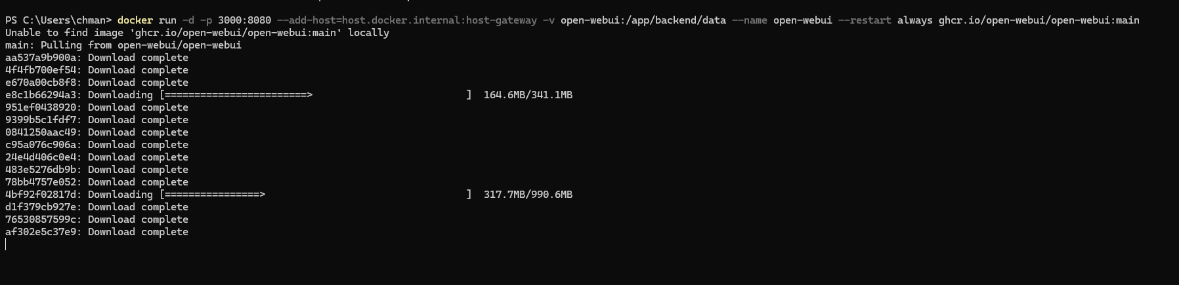
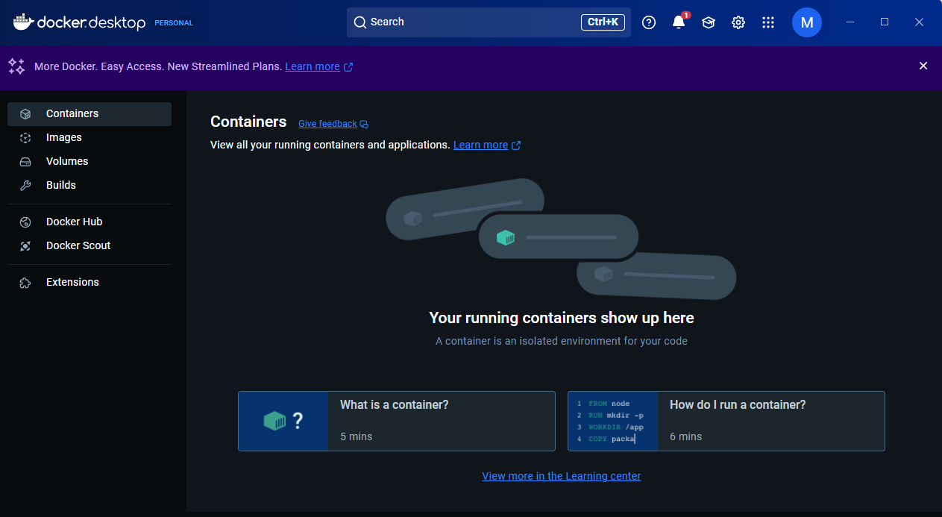
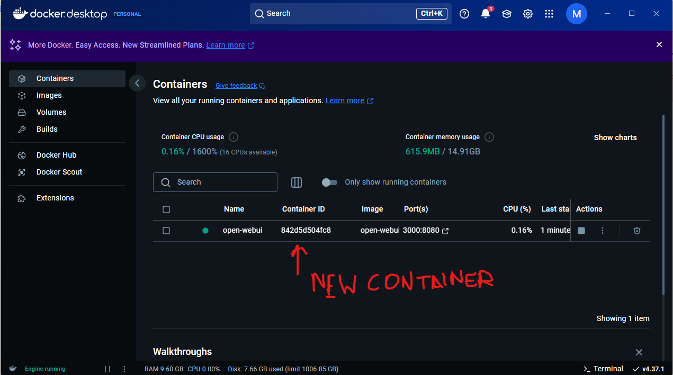
Installation of OPEN-WEB-UI
Wait until the download is completed and you see a new item in your Docker desktop application
*Remove or pause the getting-started default container as its now required

Slide 21
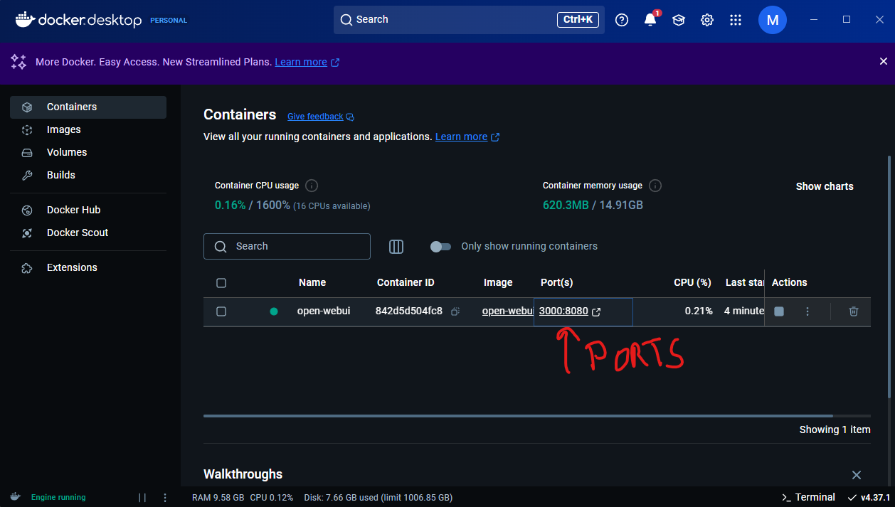
Installation of OPEN-WEB-UI
Let the installation and running setup be completed
Now click on Ports hyper link to open the web interface for Open-Web-UI
Proceed to next slide for Usage Instructions

Slide 22
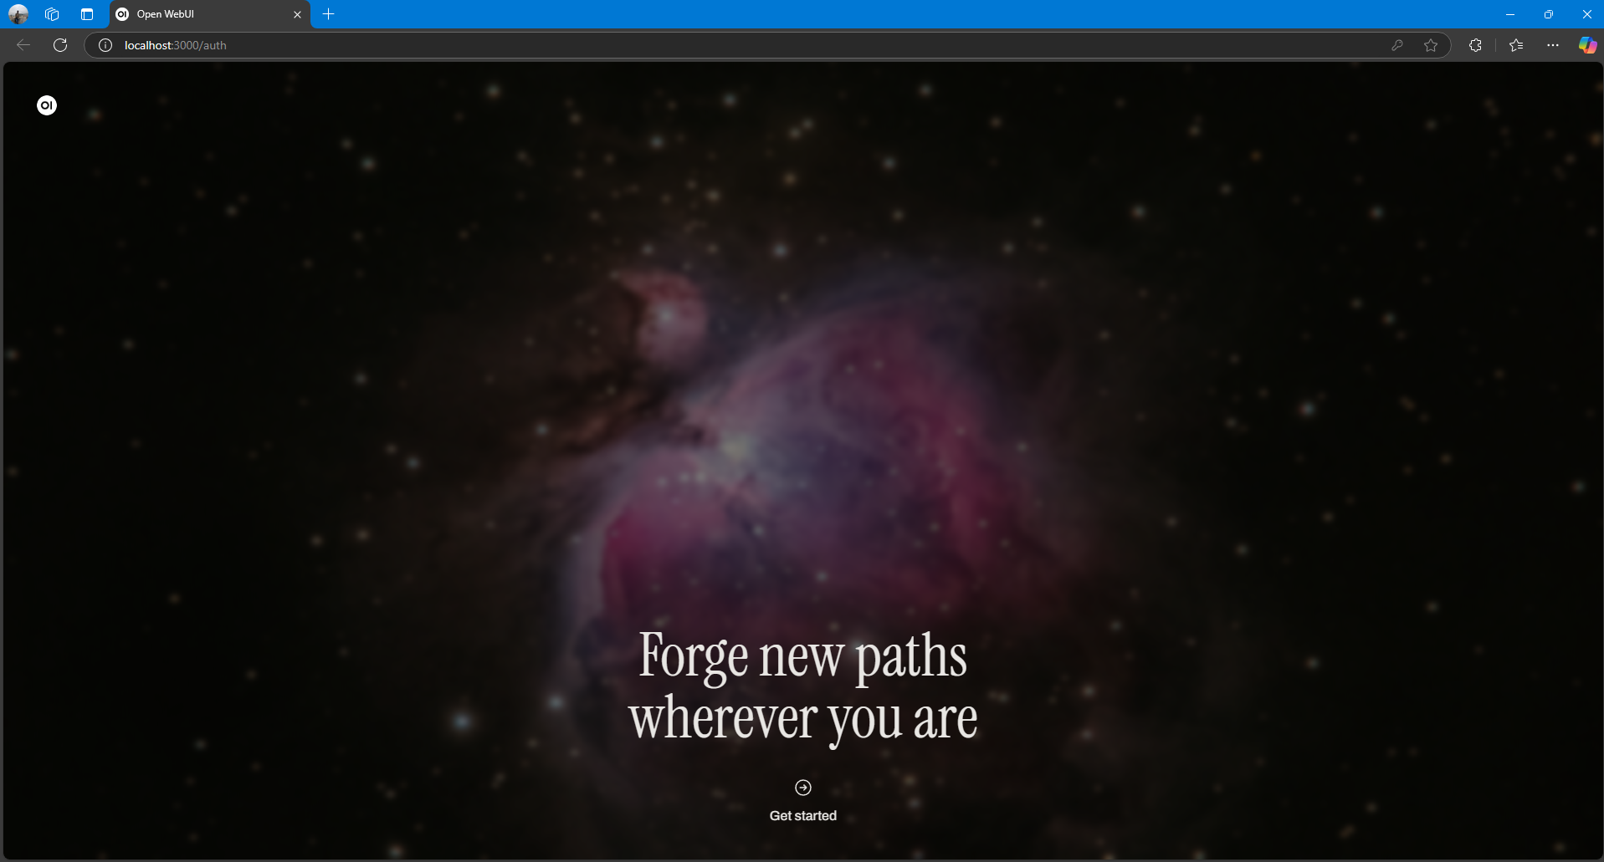
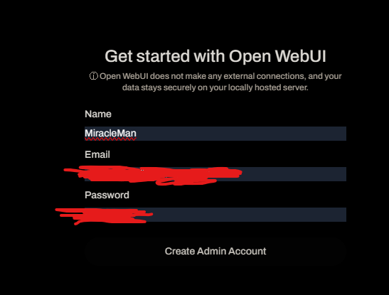
SETUP of OPEN-WEB-UI
You will be greeted with a webpage hosted at http://localhost:3000/auth
Now here we need to create an administrator account for Open-WebUi
Click on Get Started
Create an Administrator account for Open-WebUi management
Click register and proceed with Login

Slide 23
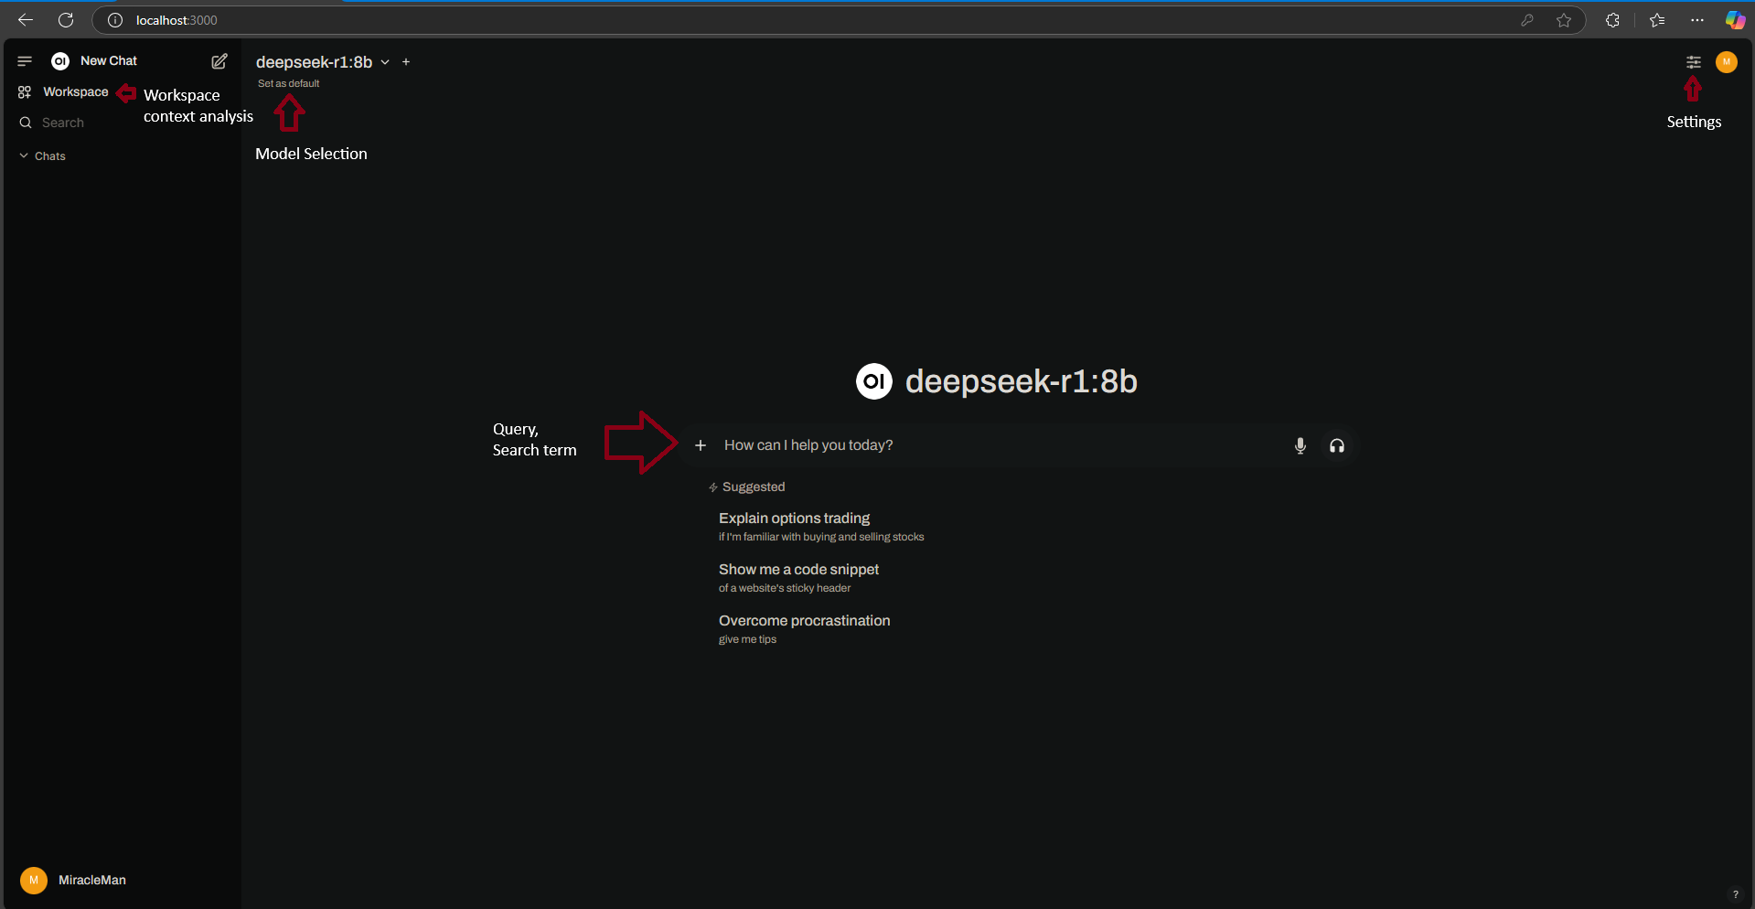
Usage of OPEN-WEB-UI
Contextual Representation

Slide 24
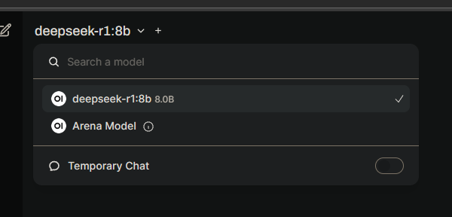
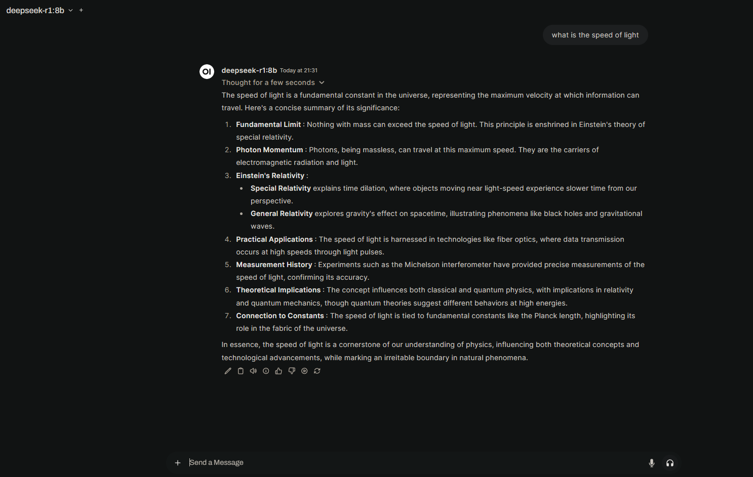
Usage of OPEN-WEB-UI
Select the model(already installed from OLLAMA) you want to run the query for.
Enter you query in the search field and get the response from AI Models

Slide 25
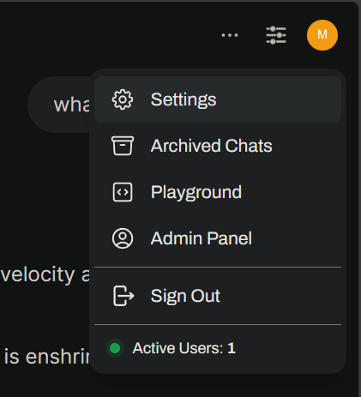
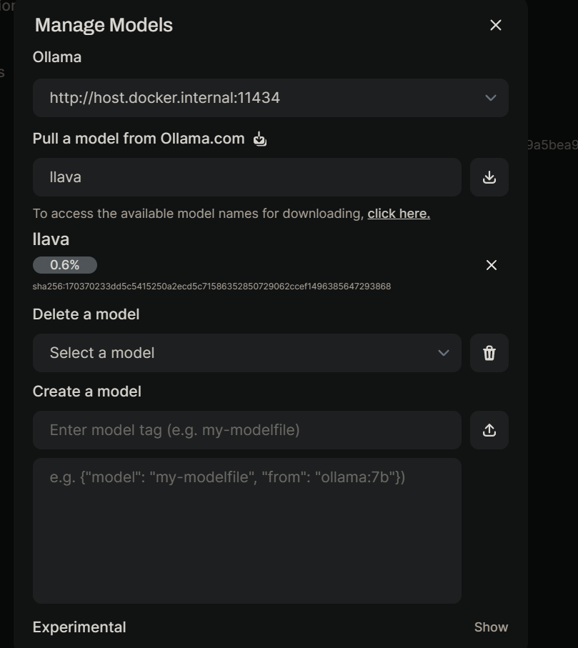
Additional Settings of OPEN-WEB-UI
Go to settings-> Admin settings
Use Models to directly run the OLLAMA installation query from OpenwebUI
Installing llava Ai model from Ollama via the WEBUI

Slide 26
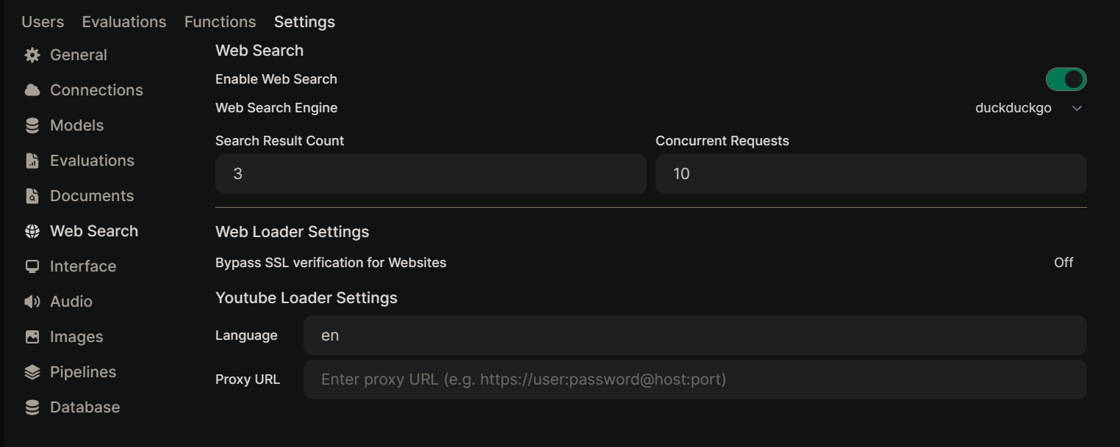
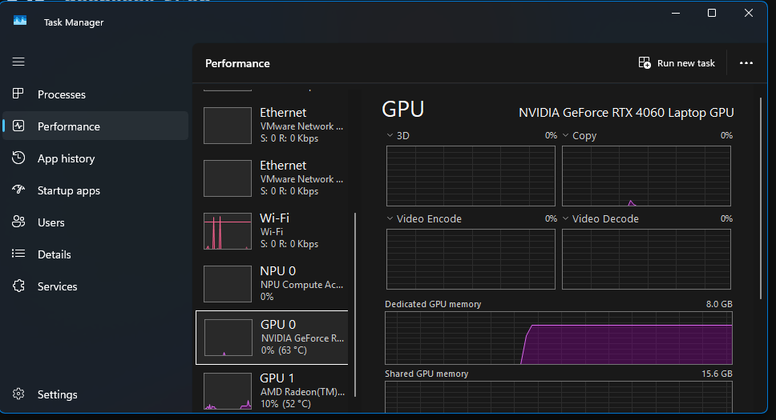
Additional Settings of OPEN-WEB-UI
Enabling Internet references for AI Model(if required) Settings->Admin Settings -> Websearch
Toggle the WebSearch to On and select your proffered search engine to refer your queries with
Check and Verify if your Ollama is working on your GPU by verifying the Dedicated Memory usage

Slide 27
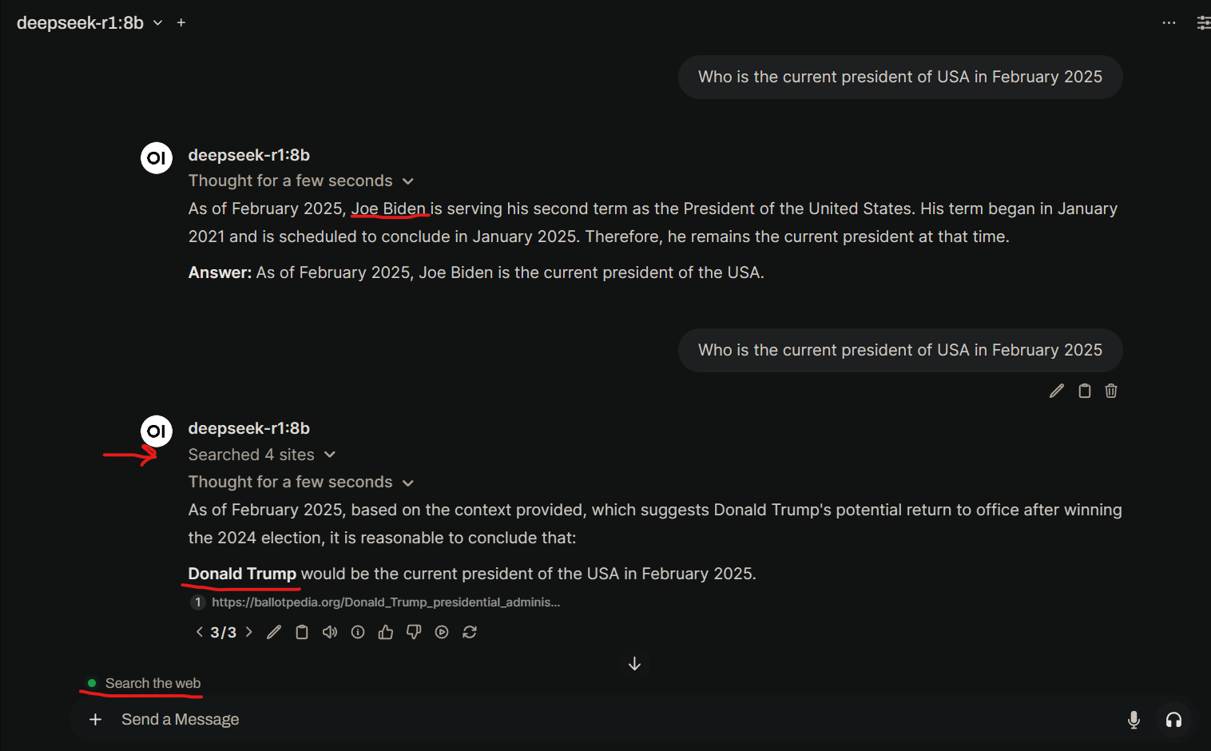
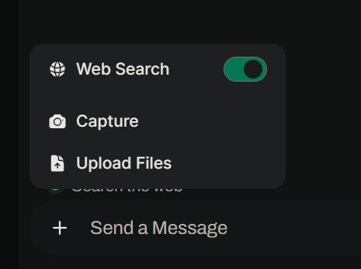
Web Search for OPEN-WEB-UI
Enable the Web search to get the latest References *the accuracy of the query will depend on the search results returned by the Search Engine

Slide 28
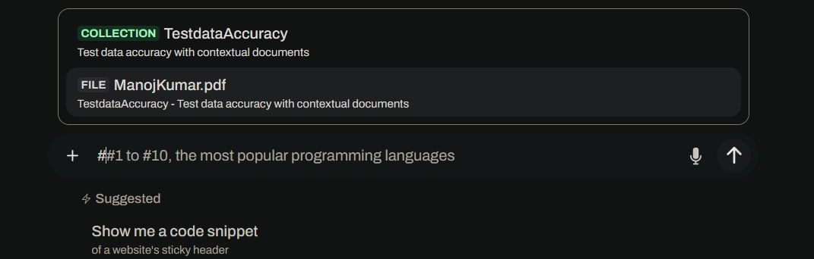
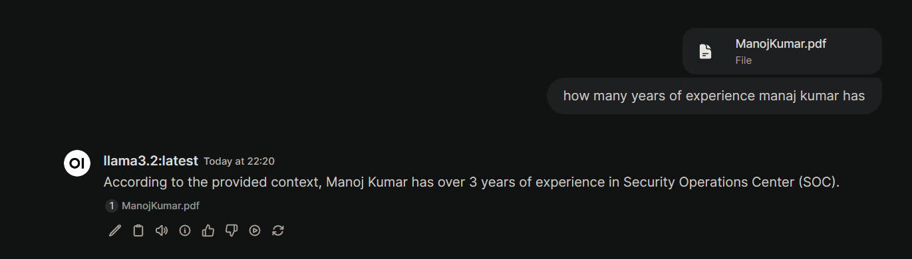
Tuning the AI Models
We can Tune the AI models by providing context documents, Resources and weblinks
Workspace-> knowledge->+(add) and add the contextual file We can also Make a Copy of model and build its Database and hence direct it toward a specialization and hence resulting in accurate results in the specified field

Slide 29
Conclusion
Use cases
Secure Usage Settings
Resources USED

Slide 30
Use Cases
Create , Build and Tune your own Local AI which is More Secure than using the Publicly available AI models which can use your input to learn and collect your data
Use AI as your default Search Engine by letting the AI generate the immediate Results crawling the web instead of browsing the internet for the correct information through various articles
Create Specialized Models for Specialized fields through Retrieval Augmented Generation (RAG)

Slide 31
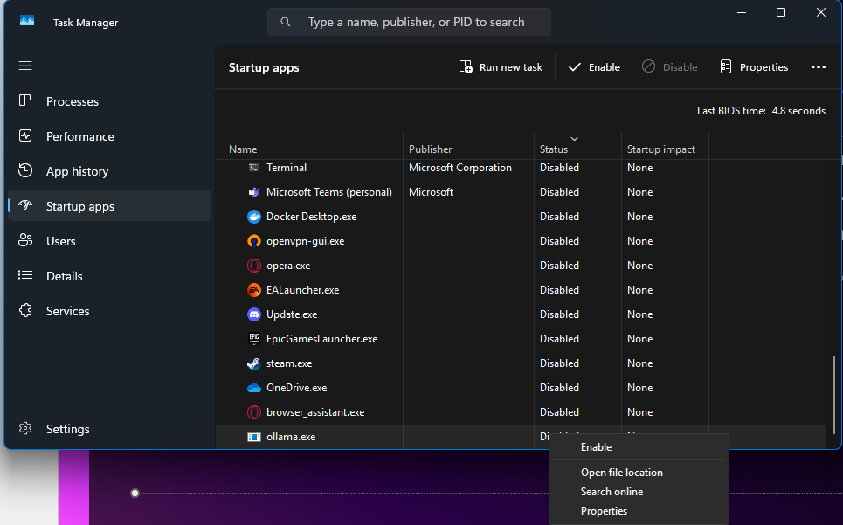
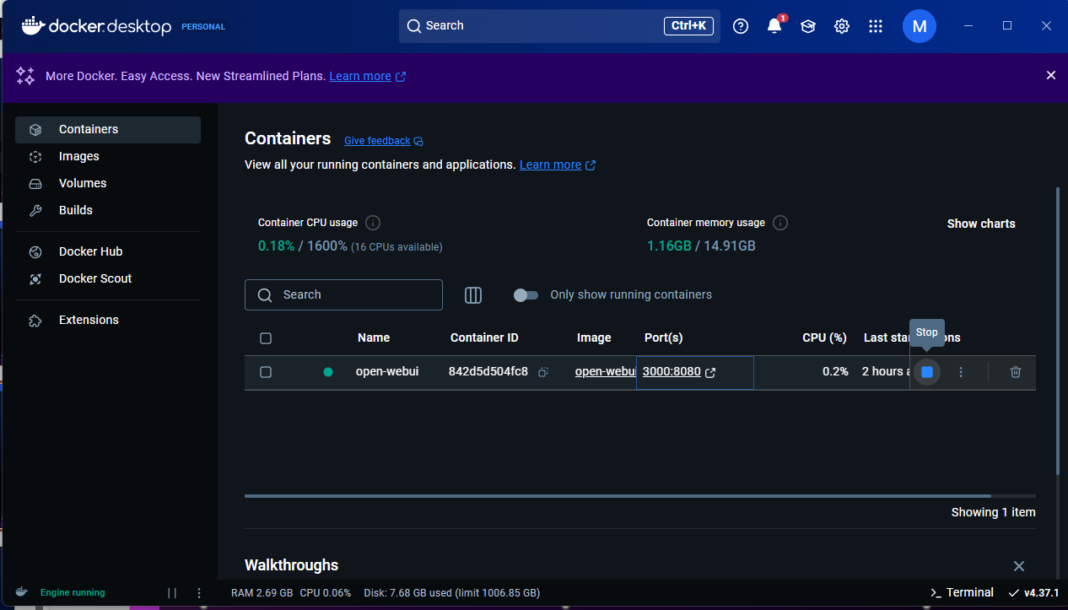
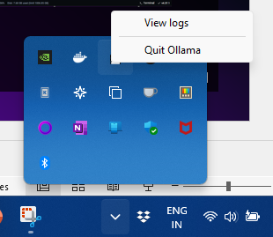
Secure Usage Setting
Set the Ollama and Docker to be disabled as startup application in windows settings
Stop the WebUi container from the docker instance when not in use
When all your work is done, quit the Ollama and Docker application from the action center

Slide 32
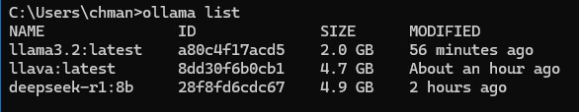
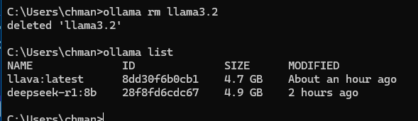
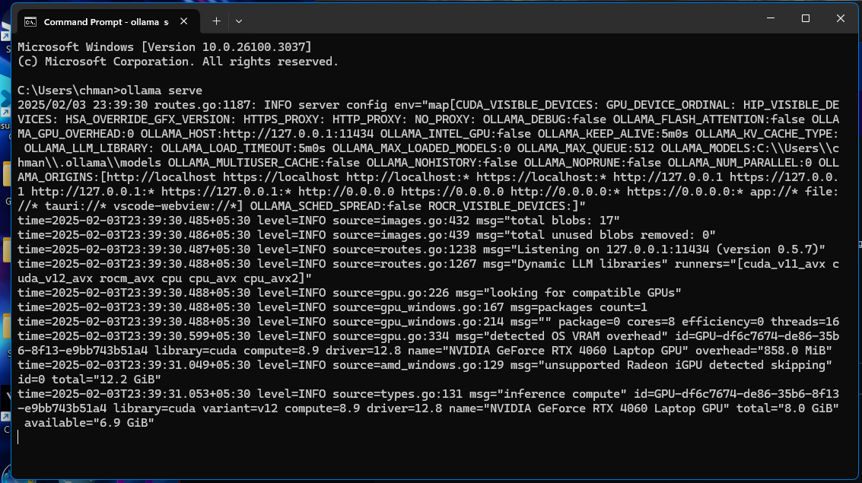
Additional Usage Commands for OLLAMA
Use Ollama list to see all the available models
Remove the unused models using ollama rm <modelname>
Ollama Serve to serve the Ollama service to the open-web-ui service

Slide 33
Resources USED
https://www.youtube.com/@DavesGarage
https://www.youtube.com/@datasciencebasics
https://www.youtube.com/@TechWithTim

Slide 34
THANK YOU
Manoj Kumar Chollangi​
+91 9154689407
Linkedin.com/in/manoj-kumar-chollangi
https://github.com/chollangimanojkumar
www.miraclemanojkumar.com

